Slide 1
MQTT-CoAP Exercise (Part 1)
Course 34351 Access- and Home Networks

Slide 2
MQTT-CoAP exercise
The MQTT-CoAP exercise is the second of the mandatory exercises in course 34351
Takes place over three consecutive weeks:
Date | Topic
2025-03-13 | Introduction to the exercise, Exercise Part 1 (MQTT)
2025-03-20 | Exercise part 2 (CoAP)
2025-03-27 | Exercise wrap-up if there are parts you’re missing – otherwise work on your journal
2025-04-03 | Deadline for handing-in the journal to the assignment on DTU Learn @13.00

Slide 3
MQTT-CoAP exercise (2)
Hand-in of reports: Individually or in groups of 2-3 students
Deadline: Wednesday, April 3 at 13.00
You have to join a group on Learn to be able to hand-in
  Even if you work individually (i.e., if you’re a one-person “group”)
    It can be the same group as for the Mininet-WiFi exercise - or a new group if you wish
  Go to My Course => Groups on Learn
    Find an empty group (“0/3 members”)
    Click on group to join (should be done by both of you for two-person groups)
  Contact me if you have trouble with groups

Slide 4
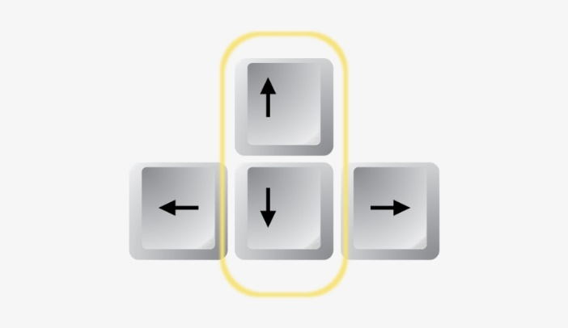
General tips
Saving output from Linux commands/scripts:
  Linux CLI: command 2>&1 | tee outputfile.txt
Use the up and down arrow keys on your keyboard to
quickly scroll up and down in your command history.

Slide 5
Virtual networks in Linux
Network namespaces are used to create a virtual network for the exercise:
  Scripts in the /home/user/mqtt directory
  In a terminal: cd mqtt
netgenerate.sh - Generates a virtual network
  Execute: sudo ./netgenerate.sh
    Generates the virtual network on the right
    and opens an Xterm window on each host
  Options:
    --noxterms Generates the network but doesn’t open Xterm windows
    --numhosts <N> Generates a network with N hosts instead of 3.
clearnet.sh - Deletes the virtual network
  Execute (in the mqtt directory): sudo ./clearnet.sh

Slide 6
MQTT Software
Based on the Eclipse Mosquitto broker and clients (https://mosquitto.org)
Website includes documentation that you will need, e.g., command line arguments for
  mosquitto - The broker
  mosquitto_pub - A publisher client
  mosquitto_sub - A subscriber client

Slide 7
Assignment
Go through the steps of the MQTT-CoAP exercise document on Learn
  MQTT is the focus of Part 1
Write an lab journal where you answer the questions in the manual
  You don’t need to write a loooooong novel for each part
  But your answers must be documented!
Continue with Part 2 next week (focus on CoAP), adding to your lab journal
Hand-in the complete lab journal on Learn no later than April 3 @ 13.00.

